Slide 1



Training duration : 45 days
Data Science with Machine Learning and Artificial Intelligence
Team members :
Chetan Singh Chouhan
Aman Choudhary
Abishek Kumar T.S
Submitted to : Mr. Ranjit Singh
Training duration : 45 days

Slide 2

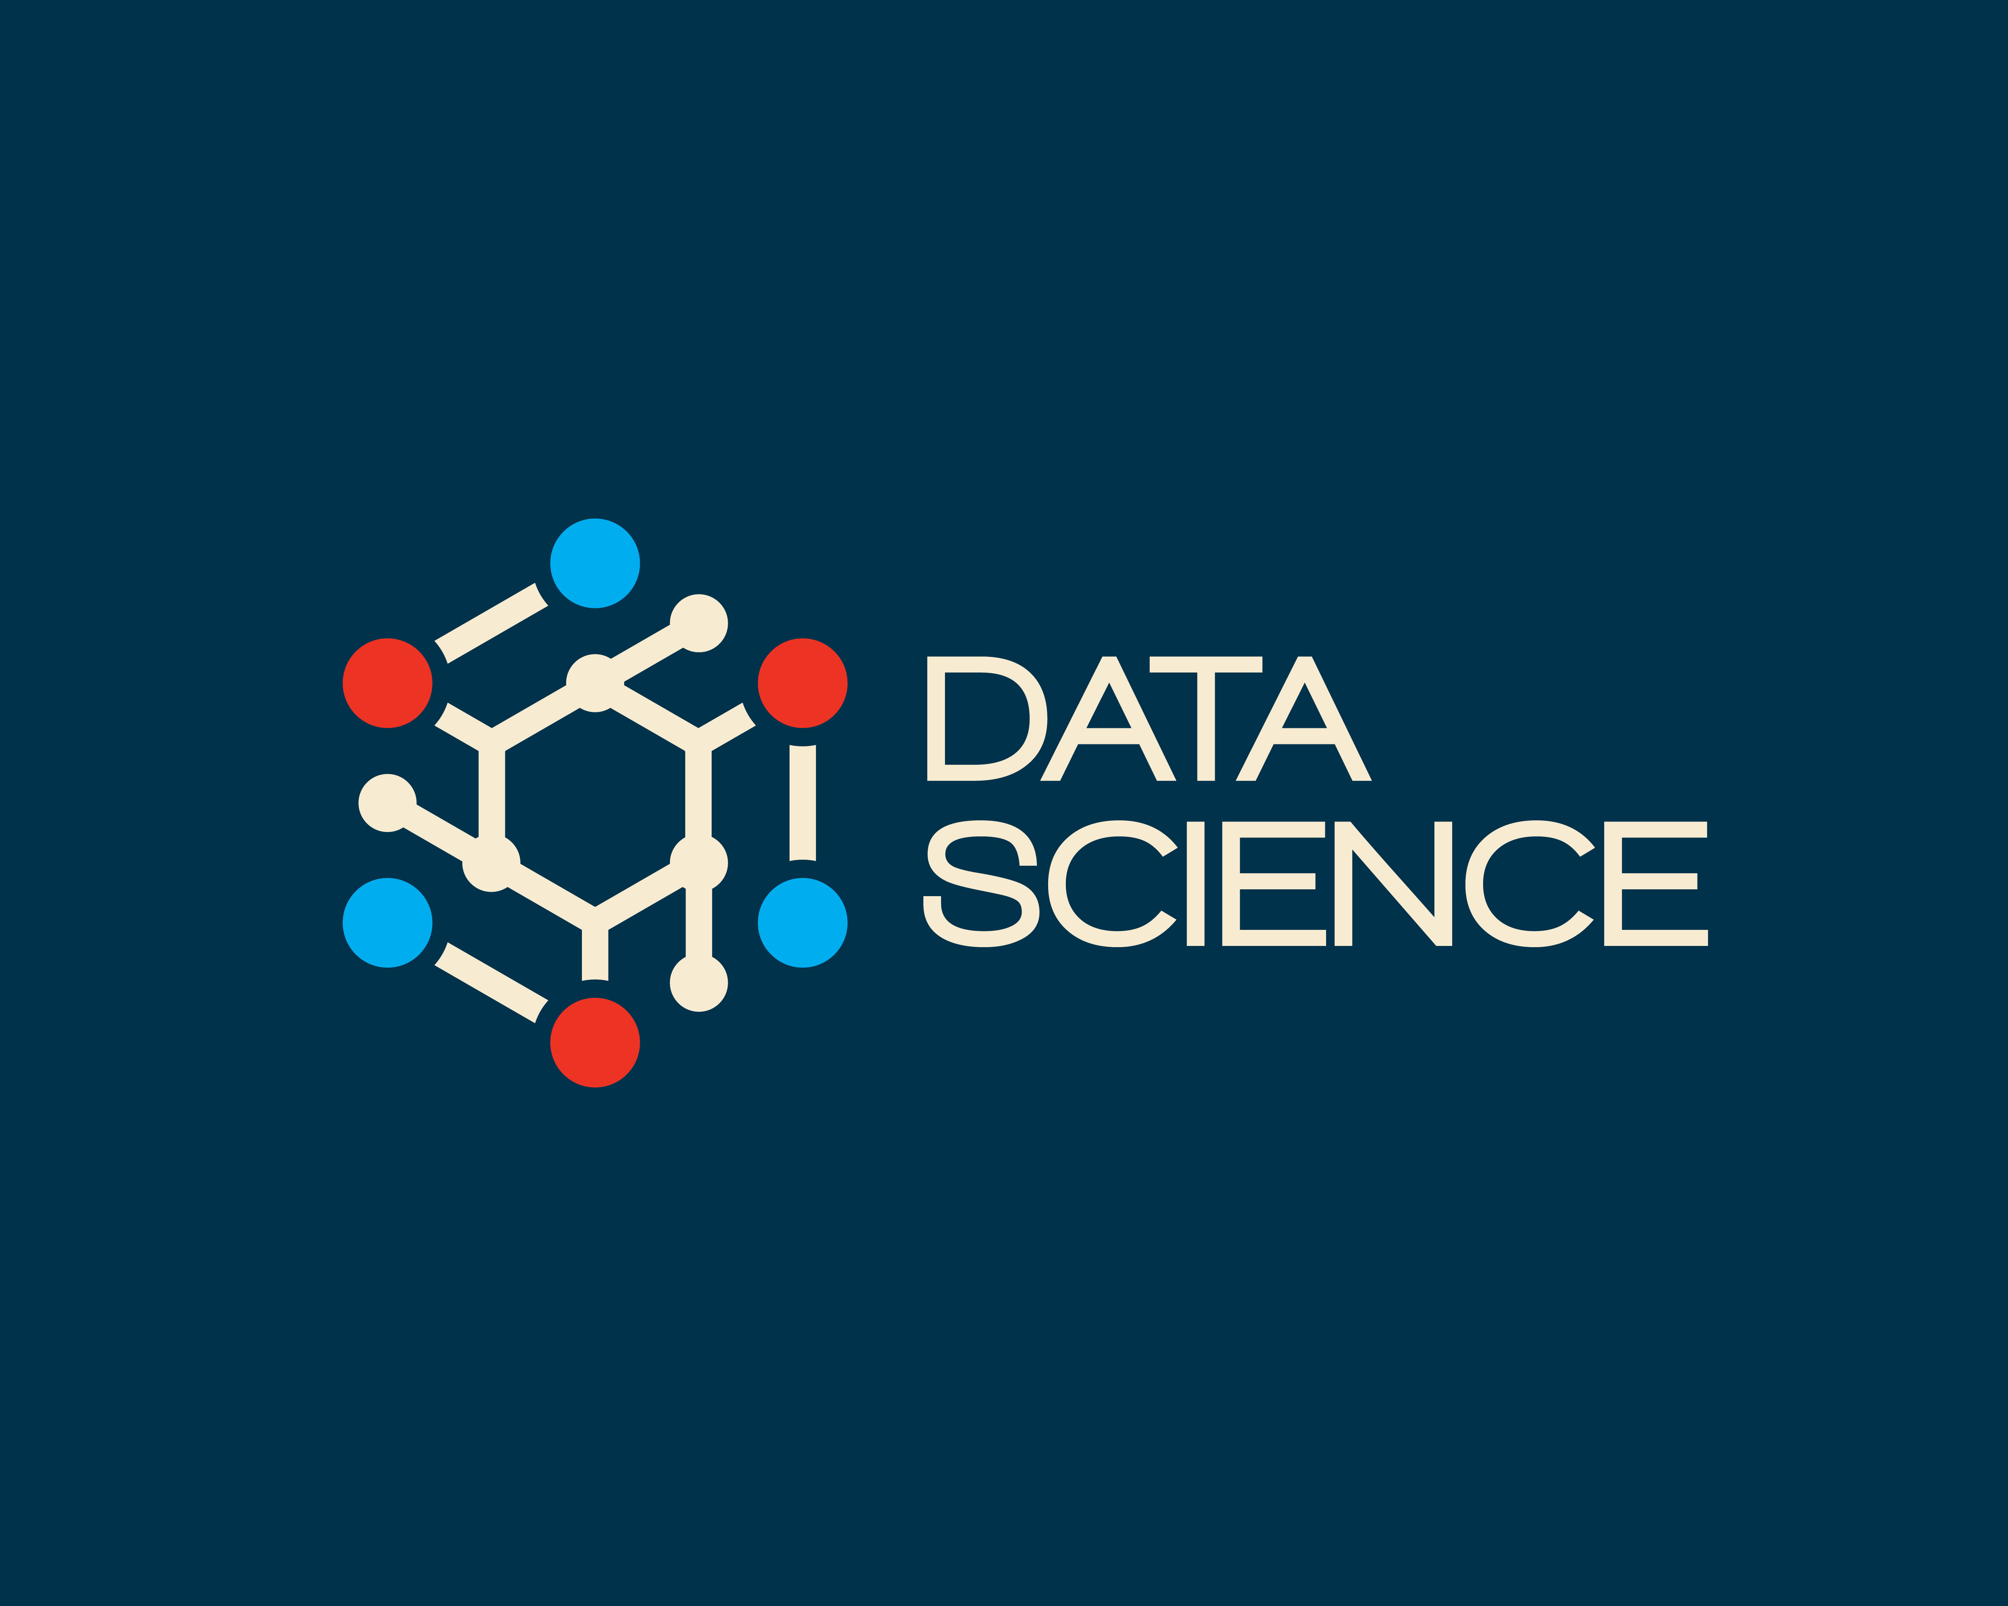
Contents
1
Basics of Python Programming
2
Libraries of Python Programming
OS
NumPy and Pandas
Matplotlib and Seaborn
ScikitLearn
Flask and TensorFlow
3
Machine Learning Algorithms
Supervised Learning
Unsupervised Learning
4
Deep Learning
ANN
CNN
RNN
5
Internship Projects
6
Final Project

Slide 3
Basics of Python Programming
Overview of My Training During My Internship
Variables, Data Types, and Operators
Learned how to declare variables, understand different data types, and perform operations using Python's builtin operators.
Control Structures: Loops and Conditional Statements
Gained handson experience with control flow, using loops (`for`, `while`) and conditional statements (`if`, `elif`, `else`) to build dynamic and efficient code.
Functions, Modules, and Lambda Expressions
Developed skills in creating reusable code blocks with functions, organizing code using modules, and utilizing lambda functions for concise, anonymous operations.
Error Handling and File Operations Explored techniques for managing errors and exceptions, along with reading from and writing to files, ensuring robust and reliable code.

Slide 4
Libraries of Python Programming
OS: Provides functions to interact with the operating system, such as file manipulation and command execution.
NumPy and Pandas: NumPy enables efficient numerical computations, while Pandas offers powerful data manipulation tools.
Matplotlib and Seaborn: Matplotlib creates customizable plots, and Seaborn builds on it to produce aesthetically pleasing statistical graphics.
ScikitLearn: A machine learning library offering simple and efficient tools for data analysis and predictive modeling.
Flask and TensorFlow: Flask is a lightweight web framework, while TensorFlow is a comprehensive library for building and training machine learning models.

Slide 5

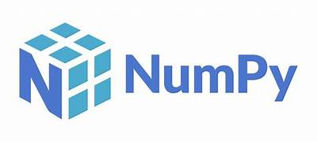
NumPy
NumPy is a powerful Python library used for numerical computing. It provides support for large, multidimensional arrays and matrices, along with a collection of mathematical functions to perform fast operations on these arrays. NumPy is essential for scientific computing in Python because it offers efficient handling of data and is the foundation for many other libraries like Pandas, Matplotlib, and SciPy. It is widely used for tasks such as array manipulation, numerical calculations, and data analysis.

Slide 6

Pandas
Pandas is a versatile Python library used for data manipulation and analysis. It provides data structures like Series (onedimensional) and Data Frame (twodimensional) that allow you to store and manipulate large datasets with ease. Pandas is essential for data cleaning, exploration, and transformation, making it a key tool for data analysis in Python. It enables tasks such as filtering, aggregating, and merging data, and it’s widely used in data science and machine learning for preparing data for analysis and modeling.

Slide 7
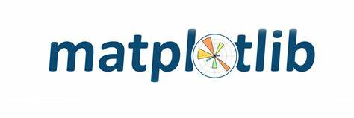

Matplotlib & Seaborn
Matplotlib is a comprehensive Python library for creating static, animated, and interactive visualizations. It serves as a fundamental tool for generating a diverse range of plots, including line graphs, bar charts, histograms, and scatter plots. Matplotlib offers extensive customization options, allowing users to finetune plot elements like labels, grids, and legends. Its versatility makes it an essential library for data visualization, helping users to explore and present data effectively.
Seaborn is a Python visualization library built on top of Matplotlib that provides a highlevel interface for creating attractive and informative statistical graphics. It simplifies the process of generating complex visualizations like heatmaps, violin plots, and pair plots, while also enhancing Matplotlib's aesthetics with builtin themes and color palettes. Seaborn is particularly useful for visualizing and understanding data distributions and relationships, making it a valuable tool for data analysis and exploration.

Slide 8
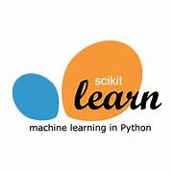
Scikit-learn
Scikitlearn is a powerful and widelyused Python library for machine learning and data analysis. It provides simple and efficient tools for data mining and data analysis, built on top of NumPy, SciPy, and Matplotlib. Scikitlearn includes a comprehensive range of algorithms for classification, regression, clustering, and dimensionality reduction, as well as tools for model selection and evaluation. Its userfriendly API and extensive documentation make it accessible for both beginners and experienced practitioners, enabling efficient development and deployment of machine learning models.

Slide 9

Flask
Flask is a lightweight and flexible Python web framework designed for building web applications and APIs. It provides a simple and intuitive interface for creating and managing web servers, handling HTTP requests, and rendering dynamic web content. Flask is known for its minimalistic approach, allowing developers to start with a basic setup and scale up by integrating additional components and libraries as needed. Its modular design and ease of use make it a popular choice for both small projects and largescale applications, offering a balance of simplicity and extensibility for web development.

Slide 10
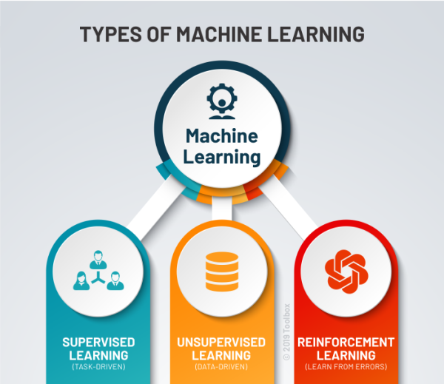
Introduction to Machine Learning :
Machine learning is a branch of artificial intelligence that enables computers to learn from data and make decisions without being explicitly programmed. It involves training algorithms on large datasets to identify patterns and make predictions. Key steps include data collection, preprocessing, model training, evaluation, and tuning. Machine learning is widely used in applications like recommendation systems, image recognition, and predictive analytics.

Slide 11
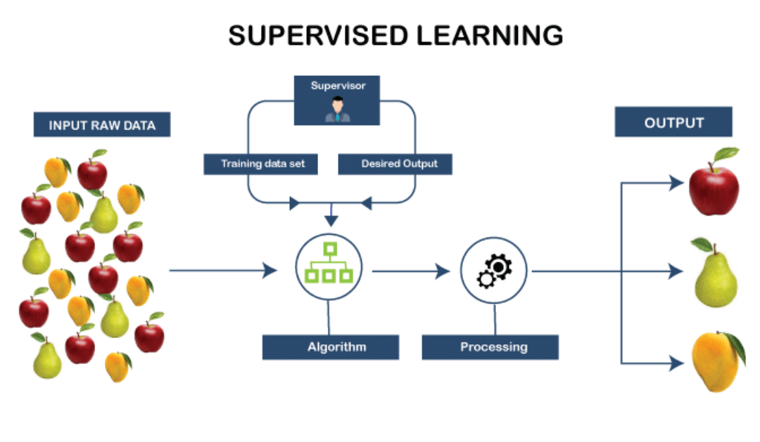
Supervised Learning:
Supervised learning is a type of machine learning where a model is trained on labeled data. This means the algorithm learns from inputoutput pairs, where each input has a known output. The goal is to predict the output for new, unseen inputs based on this learned relationship. Common tasks include classification (e.g., spam detection) and regression (e.g., predicting prices).

Slide 12
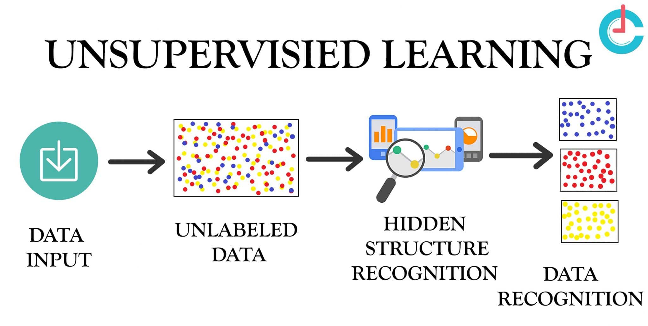
Unsupervised Learning:
Unsupervised learning involves training models on data that does not have labeled outcomes. The model seeks to identify patterns, groupings, or structures within the data without prior knowledge of the correct answers. This approach is useful for exploring data and uncovering hidden relationships. Common applications include clustering, where the model groups similar items together (e.g., customer segmentation), and dimensionality reduction, which simplifies data while preserving important information (e.g., data visualization).

Slide 13


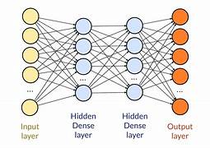
Introduction to Deep Learning:
Deep learning is a specialized area of machine learning that uses neural networks with many layers to analyze and learn from large amounts of data. By processing data through these deep networks, the models can automatically discover intricate patterns and make predictions. Deep learning is widely used for tasks like image and speech recognition, and natural language processing. Its ability to handle complex data makes it a powerful tool in advancing technologies such as selfdriving cars and virtual assistants.

Slide 14
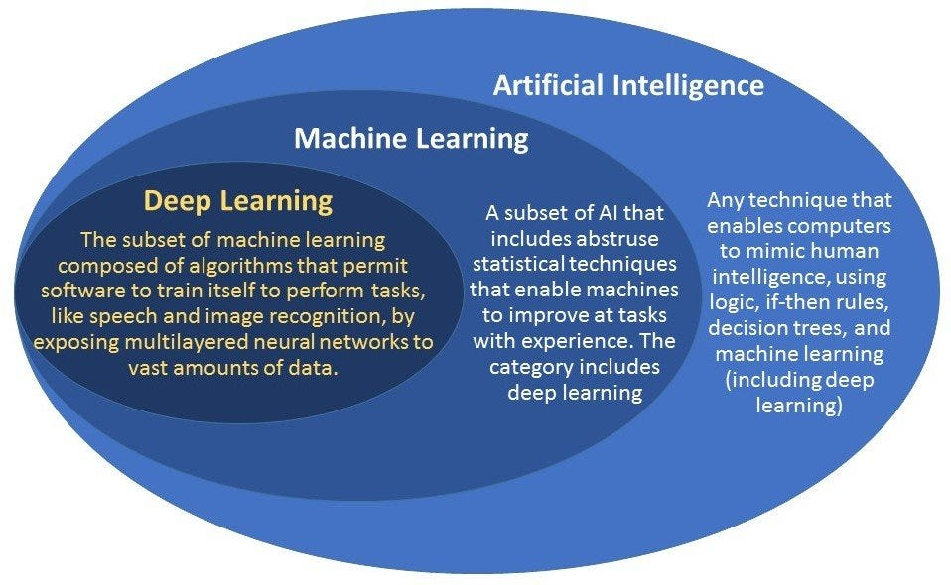

Slide 15
Artificial Neural Networks (ANN):
An Artificial Neural Network (ANN) is a type of machine learning model inspired by the structure and functioning of the human brain. It consists of layers of interconnected nodes, called neurons, which process information and pass it through the network.
Key components of an ANN include:
Input Layer: Receives the raw data that needs to be analyzed.
Hidden Layers: These intermediate layers transform the input data into something the output layer can use. Each neuron in a hidden layer is connected to every neuron in the previous and next layers, with weights that determine the strength of these connections.
Output Layer: Produces the final output, such as a prediction or classification.
How it works:
The ANN is trained using a dataset, and through a process called backpropagation, it adjusts the weights of the connections between neurons to minimize the error in its predictions.
Activation Functions: These functions introduce nonlinearity to the model, enabling it to capture complex patterns in the data.
ANNs are fundamental in many deep learning applications, such as image and speech recognition, natural language processing, and gameplaying algorithms, due to their ability to model complex relationships in large datasets.

Slide 16
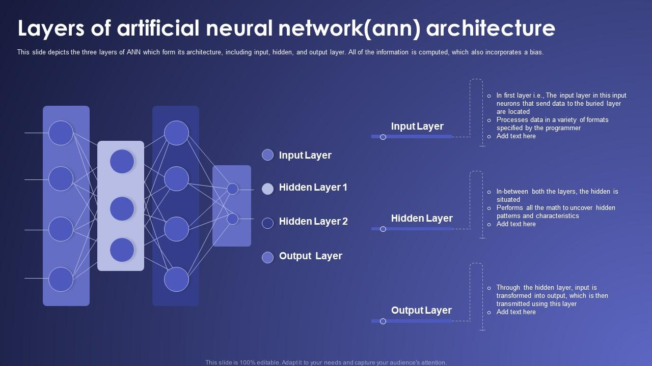
Data Science Projects

Slide 17
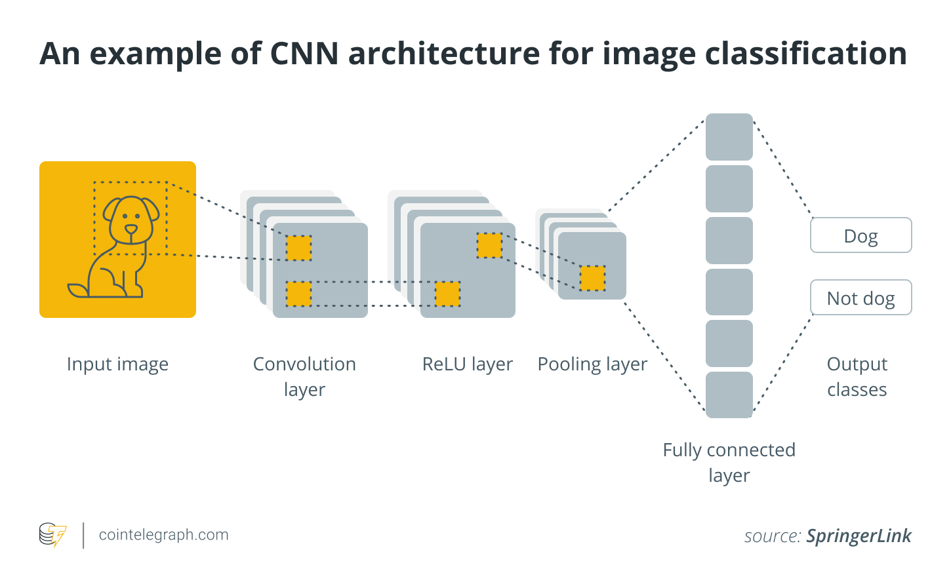
Convolutional Neural Network (CNN):
A Convolutional Neural Network (CNN) is a type of deep learning model specifically designed for processing and analyzing visual data, such as images. It uses convolutional layers to automatically detect patterns and features, making it highly effective for tasks like image recognition and classification.

Slide 18
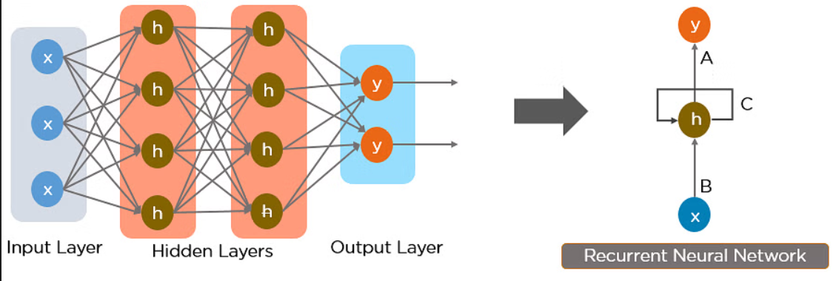
Recurrent Neural Network (RNN):
A Recurrent Neural Network (RNN) is a type of neural network designed for sequential data. Unlike other neural networks, RNNs have loops that allow information to persist, making them wellsuited for tasks like speech recognition, language modeling, and time series prediction. This ability to process sequences of data makes RNNs ideal for analyzing text, audio, and other timedependent data.

Slide 19
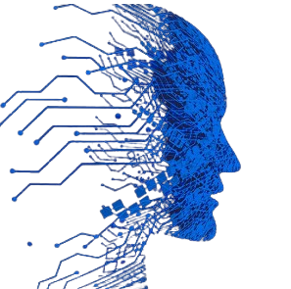
Artificial Intelligence (AI)
Definition: Artificial Intelligence (AI)
Artificial Intelligence (AI) refers to the simulation of human intelligence in machines that are designed to think, learn, and perform tasks that typically require human intelligence. AI encompasses a wide range of capabilities, including learning, reasoning, problemsolving, perception, and language understanding.
Key Areas:
Machine Learning (ML): Enables machines to learn from data and make predictions or decisions without being explicitly programmed.
Natural Language Processing (NLP): Allows machines to understand, interpret, and generate human language.
Computer Vision: Enables machines to interpret and analyze visual data from the world.
Applications:
AI is widely used across various industries, including healthcare (e.g., diagnostic tools), finance (e.g., fraud detection), autonomous vehicles (e.g., selfdriving cars), robotics (e.g., automation), and customer service (e.g., chatbots).

Slide 20
Projects
1. ATM automation
2. CLI based chat system
3. Bike price prediction
4. insurance charges premium prediction
5. Customer satisfaction prediction
6. Email classification prediction ham spam
7. Former crop production
8. RealTime Emotion Detection Using CNN, TensorFlow, and OpenCV

Slide 21
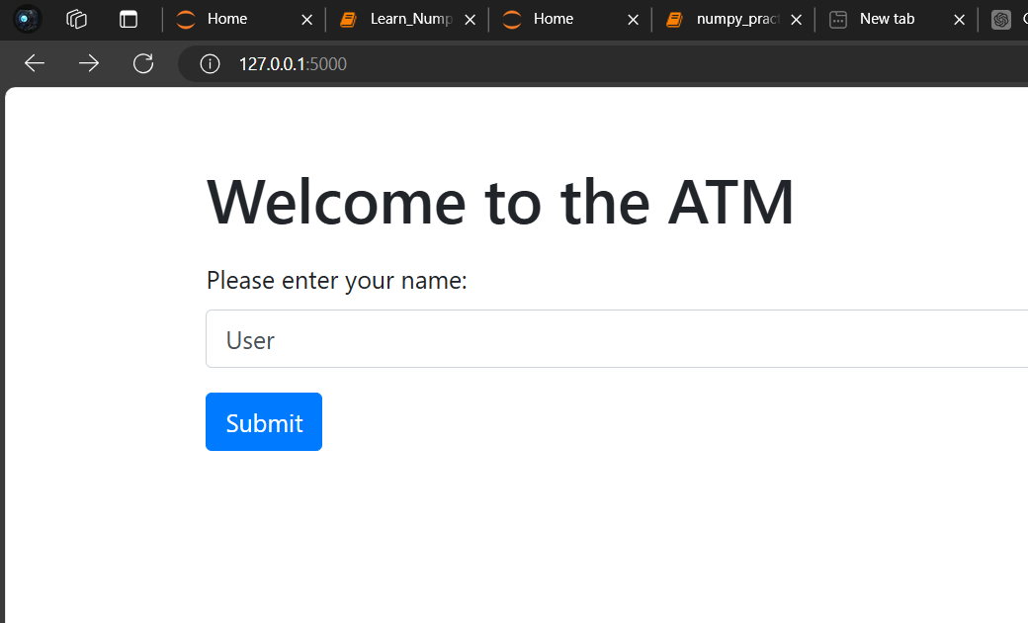
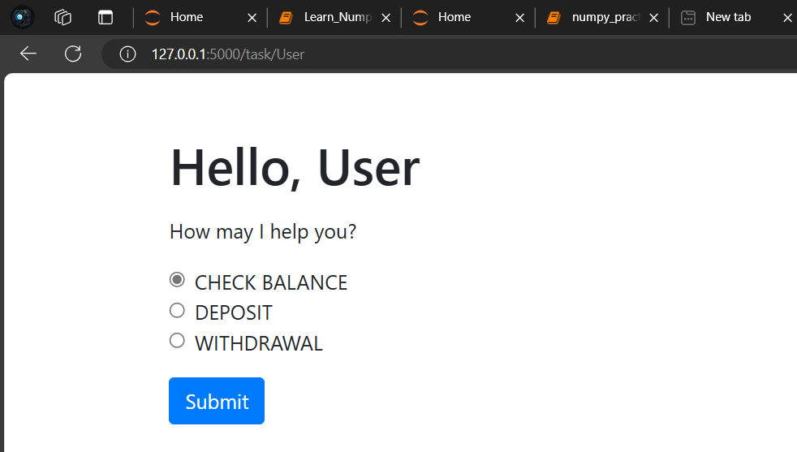
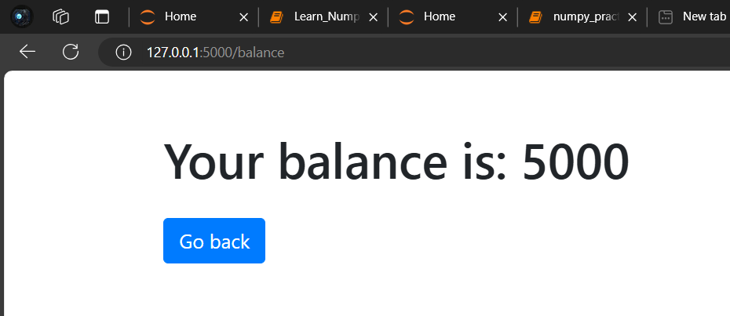
ATM automation
This web-based ATM simulation, built with Flask, allows users to check their balance, deposit money, and withdraw funds. Users log in, select a task, and interact with the system to view their balance or manage transactions.
Key features include:
Balance Inquiry: Check current balance.
Deposit: Add funds with a minimum deposit limit.
Withdraw: Withdraw funds with balance checks.
This project demonstrates basic web application development and form handling with Flask.

Slide 22
CLIBased Chat System Using Python Socket Module
Objective: Create a commandline interface (CLI) chat system using Python's socket module to enable realtime communication between a server and clients over a network.
Components:
Server (Receiver):
Setup: Establishes a UDP socket bound to a specific IP address and port.
Functionality: Listens continuously for incoming messages from clients and displays each message with the sender's address.
Data Handling: Receives and prints messages in realtime, supporting a buffer size of 100 characters.
Client (Sender):
Setup: Creates a UDP socket and connects to the server using its IP address and port.
Functionality: Allows users to input and send messages to the server, encoding messages in ASCII before transmission.
Termination: Prompts users to continue sending messages or exit the application ('Y' or 'y' to quit).

Slide 23

Bike Price Prediction
Objective: Develop a web application to predict bike prices based on various features using machine learning and data analysis techniques.
Key Features:
Data Analysis: Utilized Python libraries such as NumPy and Pandas for data manipulation and analysis.
Visualization: Used Matplotlib to visualize data trends and relationships.
Model: Implemented a Linear Regression model to predict bike prices based on features like bike condition, age, mileage, and brand.
Technologies Used:
NumPy: For numerical operations and handling arrays.
Pandas: For data manipulation and preprocessing.
Matplotlib: For data visualization and plotting.
Linear Regression: To model the relationship between bike features and their prices.

Slide 24
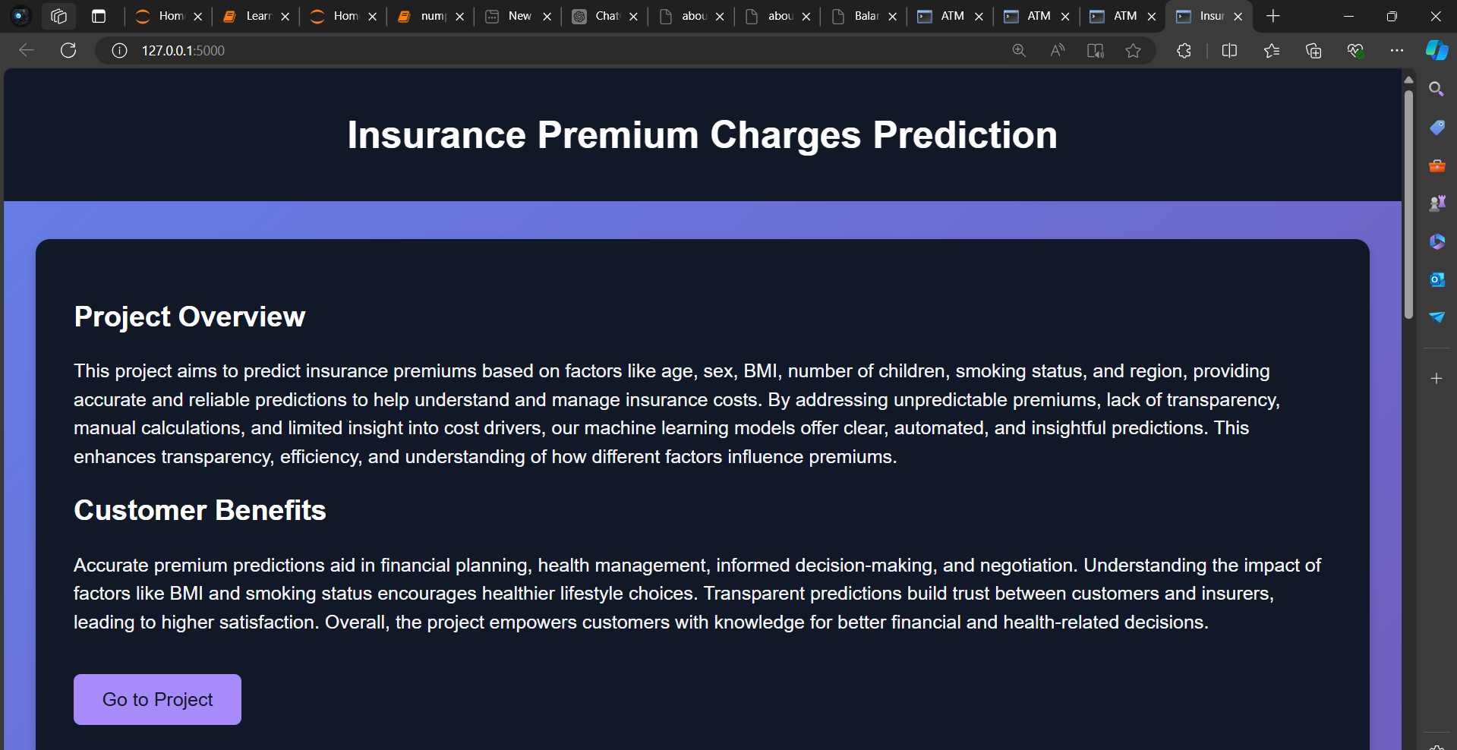
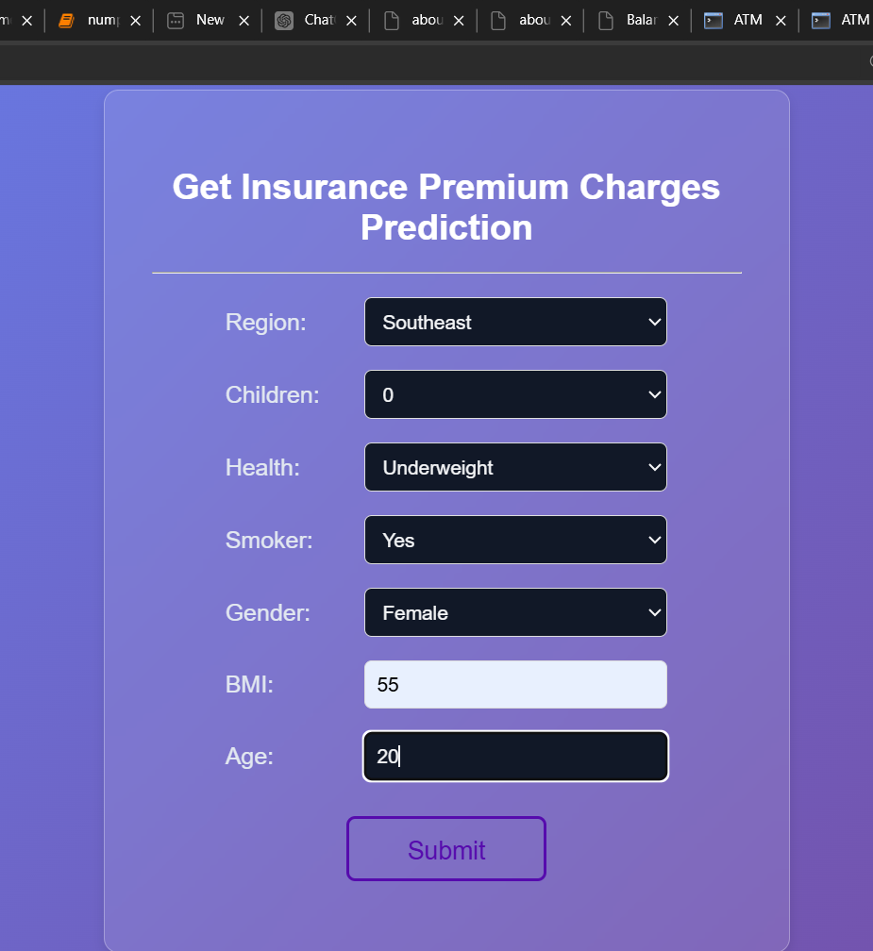
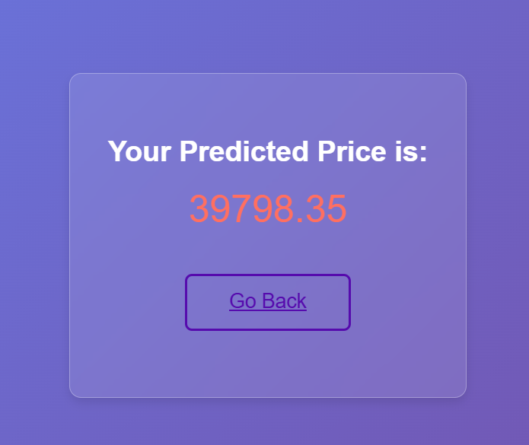

Objective: Build a web app to predict insurance charges using machine learning models, focusing on accuracy.
Key Features:
Models: Linear Regression, Decision Tree, and Random Forest.
Prediction Factors: Age, BMI, number of children, and smoking status.
Technologies: Python, machine learning libraries.

Slide 25

Airline Customer satisfaction prediction
Objective: Develop a comprehensive web application to accurately predict the satisfaction levels of airline customers using a pretrained logistic regression model. The application aims to provide a userfriendly interface where users can input various flight and servicerelated features to receive realtime satisfaction predictions.
Key Features:
Model Integration: Implements a logistic regression model to predict customer satisfaction based on input features such as flight experience, service quality, and customer demographics.
Web Interface: Built using Flask, the application offers an interactive platform for users to enter their data and receive instant satisfaction predictions, with a focus on clarity and ease of use.
Technologies Used:
Flask: A Python web framework for developing and deploying the web application.
joblib: Utilized to efficiently load and integrate the pretrained logistic regression model.
HTML/CSS: For designing the web pages, ensuring a responsive and visually appealing user interface.

Slide 26

Email Spam and Ham Classification
Objective: Create a web application that classifies emails as either 'HAM' (nonspam) or 'SPAM' using a pretrained Naive Bayes model.
Key Features:
Email Classification: Determines whether an email is 'HAM' or 'SPAM' based on the provided text input.
User Interface: Offers a web interface where users can input email content and receive classification results.
Technologies Used:
Flask: Python web framework for building the application.
joblib: Loads the pretrained model and text transformations.
Bag of Words (BoW): Converts email text into a numerical format for model prediction.
Naive Bayes Model: A Bernoulli Naive Bayes classifier used to categorize emails as 'HAM' or 'SPAM'.

Slide 27
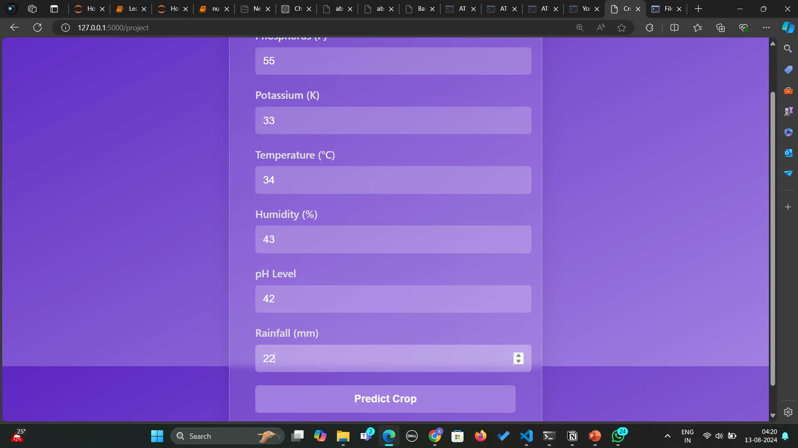
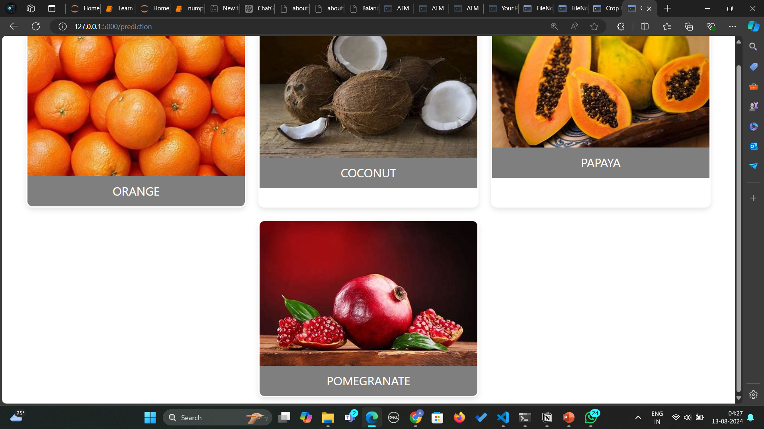
Farming crop prediction
This project aims to develop a web application that recommends the most suitable crops for cultivation based on environmental and soil parameters. Using Flask as the web framework, the application features an interactive form where users input their data. The backend employs Joblib to load pretrained models and Standard Scaler for data normalization. KMeans Clustering is used to categorize the input data into clusters, and a Pandas Data Frame maps these clusters to specific crop labels. The application then predicts and displays the optimal crops based on these clusters.

Slide 28
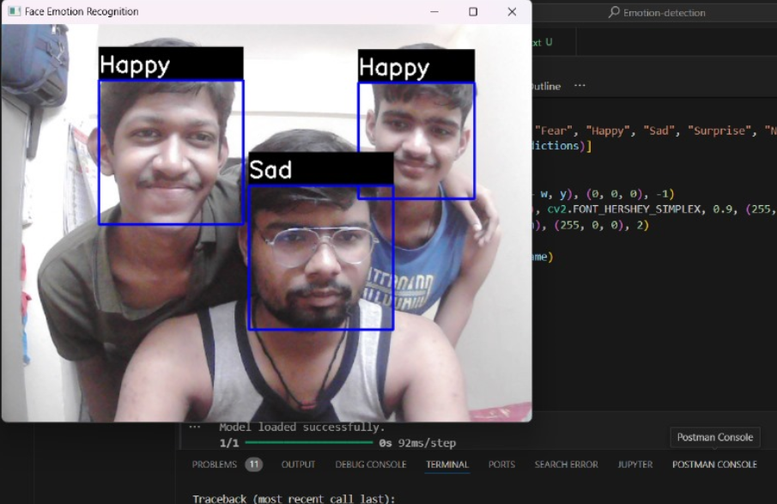
RealTime Emotion Detection Using CNN, TensorFlow, and OpenCV
Project Overview:
This project develops a robust realtime emotion detection system, leveraging deep learning and computer vision techniques. The system is capable of capturing live video from a webcam, detecting human faces, and accurately classifying emotions such as happiness, anger, sadness, and more. The implementation combines several powerful Python libraries and frameworks to achieve high performance and realtime processing.
Key Components (Model Architecture)
Sequential Model: The project uses a Sequential model from TensorFlow's Keras API, which is suitable for stacking multiple layers in a linear manner.
Conv2D Layer: Convolutional layers are employed to perform 2D convolutions on the input image, extracting essential features related to emotion detection.
MaxPooling2D Layer: Max pooling layers are added to downsample the input representation, reducing its dimensionality and computational complexity.

Slide 29
Flatten Layer: The Flatten layer is used to convert the 2D matrix data into a 1D vector, which can be processed by fully connected layers.
Dense Layer: Dense (fully connected) layers are used to perform the final classification of the input data, determining the emotion.
Dropout Layer: Dropout layers are integrated to prevent overfitting by randomly setting a fraction of input units to zero during training.
Data Handling and Augmentation:
ImageDataGenerator: This class is used for realtime data augmentation during model training, enhancing the diversity of the training dataset and improving model generalization.
Model Optimization:
Adam Optimizer: The Adam optimization algorithm is used to adjust the model's weights during training, providing an efficient and effective means of converging to an optimal solution.
EarlyStopping Callback: Early stopping is employed to monitor the model's performance during training, halting the process when improvements plateau, thereby preventing overfitting.
ModelCheckpoint Callback: The ModelCheckpoint callback is used to save the model with the best performance on the validation set, ensuring the final model is the most accurate version.

Slide 30
Computer Vision Integration:
OpenCV: OpenCV is utilized for capturing live video from the webcam, as well as for performing face detection in real time. This library provides the necessary tools to preprocess the input images before they are passed to the CNN model.
Visualization:
Matplotlib: Matplotlib is used for plotting and visualizing data, such as training and validation loss, accuracy curves, and other metrics that provide insight into the model's performance.
Training Dataset:
The model is trained on the FER 2013 dataset, which contains 28,708 training images and 7,178 test images. This dataset includes grayscale images of faces, labeled with one of seven emotions: Angry, Disgust, Fear, Happy, Sad, Surprise, and Neutral. The dataset is used to train the CNN model to recognize and classify these emotions accurately.
Conclusion:
This project demonstrates the integration of machine learning with realtime video processing to create an effective emotion detection system. By leveraging TensorFlow's deep learning capabilities, OpenCV's computer vision tools, and various optimization techniques, the system is able to provide accurate and instantaneous emotion classification from live video feeds.

Slide 31
Technical Stack:
Python Libraries: TensorFlow, Keras, OpenCV, NumPy, Matplotlib.
CNN Layers: Conv2D, MaxPooling2D, Flatten, Dense, Dropout.
Optimization and Callbacks: Adam, EarlyStopping, ModelCheckpoint.
Data Augmentation: ImageDataGenerator.
Dataset: FER 2013 (accessible [here](https://drive.google.com/drive/folders/11MouWOiB3WompIieCSnW2voIUk55Bv9Z?usp=drive_link)).
GitHub Repository: The complete project code and resources are available on GitHub Visit the repository here to explore the implementation details, view the code, and contribute to the project.

Slide 32


Conclusion
Our internship at Upflairs Pvt Ltd was an invaluable experience that equipped me with practical skills and theoretical knowledge in Python, AI/ML, and Data Science. I gained handson experience working on realworld projects and learned from experienced professionals. This internship was a stepping stone in my journey towards becoming a skilled data scientist. I am eager to apply my newly acquired knowledge and contribute to innovative projects in the field of AI and machine learning.

